Slide 1

Happy National Day

Slide 2
Memory Hierarchy Design Basics
04
Kai Bu
kaibu@zju.edu.cn
http://list.zju.edu.cn/kaibu/comparch2022

Slide 3
Memory Hierarchy?

Slide 4
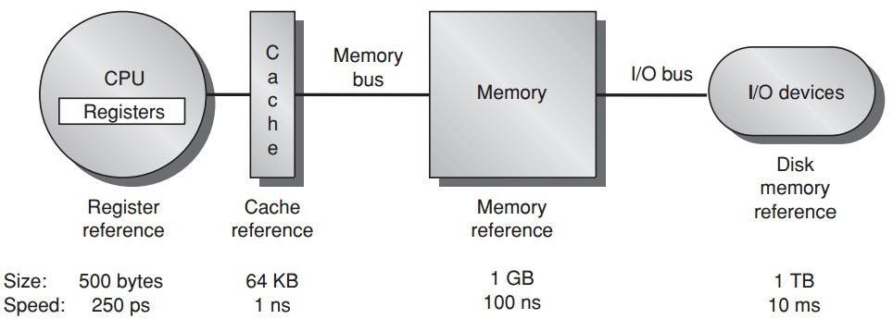
Memory Hierarchy?
Notes:
In previous lectures, we took a lot of time to understand memory hierarchy.
It consists of several levels of storage components.
After data reference leaves CPU processor, it first enters cache,
If not found, then goes to memory; then to disk if needed.

Slide 5
Memory Hierarchy?
Notes:
As each level goes farther from CPU processor,
storage size increases while processing speed slows down.
So toward faster execution,
we hope that data reference can be accommodated at as higher level as possible.

Slide 6
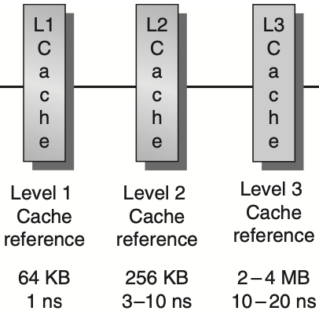
Memory Hierarchy?
faster
Notes:
To this end, we may introduce multi-level cache.

Slide 7
Memory Hierarchy?
Virtual memory
larger, safer
Notes:
To enhance memory usage efficiency and safety,
we also introduce virtual memory that integrates both physical memory and magnetic disk.
Virtual memory enables each program to independently manage allocated memory space
via indirect mapping from virtual address to physical address.

Slide 8
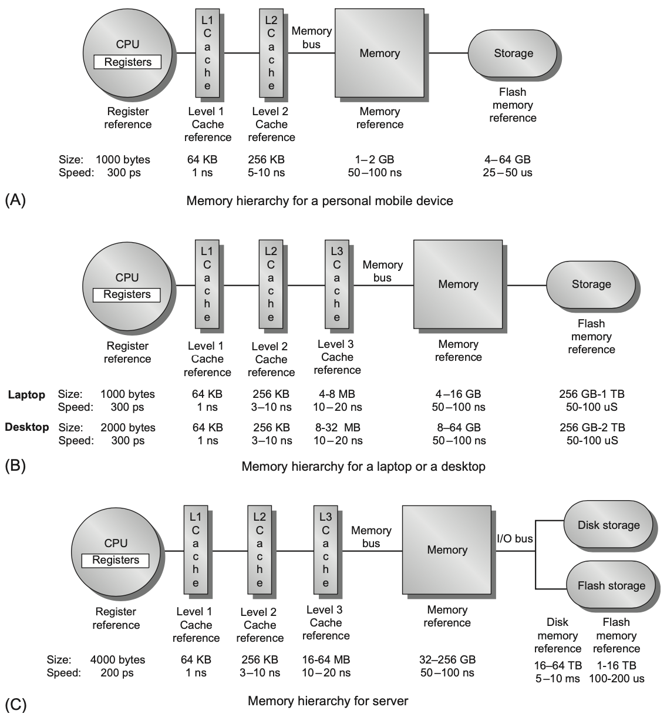
Memory Hierarchy?
Notes:
Figure 2.1 The levels in a typical memory hierarchy in a personal mobile device (PMD), such as a cell phone or tablet (A), in a laptop or desktop computer (B), and in a server (C). As we move farther away from the processor, the memory in the level below becomes slower and larger. Note that the time units change by a factor of 109 from pico- seconds to milliseconds in the case of magnetic disks and that the size units change by a factor of 1010 from thou- sands of bytes to tens of terabytes. If we were to add warehouse-sized computers, as opposed to just servers, the capacity scale would increase by three to six orders of magnitude. Solid-state drives (SSDs) composed of Flash are used exclusively in PMDs, and heavily in both laptops and desktops. In many desktops, the primary storage system is SSD, and expansion disks are primarily hard disk drives (HDDs). Likewise, many servers mix SSDs and HDDs.

Slide 9
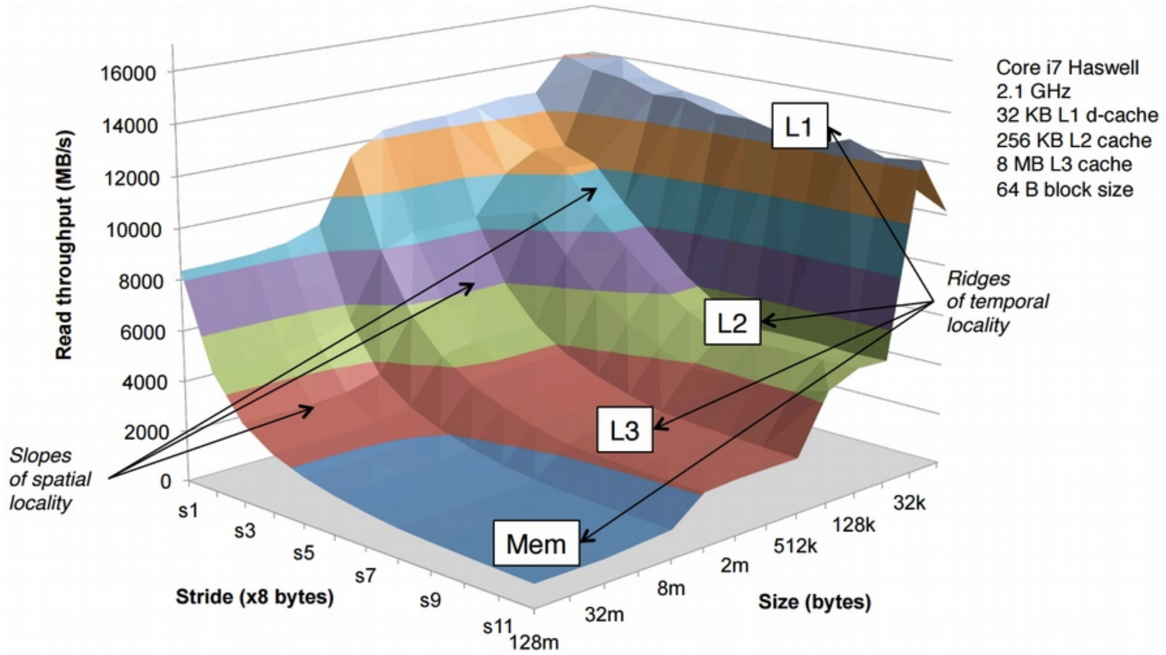
Memory Hierarchy?
The Memory Mountain
https://w3.cs.jmu.edu/lam2mo/cs261_2017_08/files/20-caching.pdf

Slide 10
Technology & Optimizations
Notes:
Chapter 2.2

Slide 11
Main Memory
Main memory: I/O interface between caches and servers
dst of input & src of output
Processor
Control
Secondary
Storage
(Disk)
Second
Level
Cache
(SRAM)
Main
Memory
(DRAM)
Datapath
On-Chip
Cache
Registers
Compiler
Hardware
Speed:
Fastest
Operating System
Slowest
Size:
Smallest
Biggest
Cost:
Highest
Lowest
Notes:
Main memory plays a very important role in the entire memory hierarchy.
It serves as the I/O interface between caches and servers/disks.
From this point of view, it is the destination of input swapped from the disk as well as the source of output generated by CPU.

Slide 12
Main Memory
Performance measures
Latency the time to retrieve the first word of the block
important for caches;
harder to reduce;
Bandwidth the time to retrieve the rest of this block
important for multiprocessors, I/O, and caches with large block sizes;
easier to improve with new organizations: e.g., multi-bank mem
Notes:
the innovation was how to organize the many DRAM chips that made up the main memory, such as multiple memory banks. Higher bandwidth is available using memory banks, by making memory and its bus wider, or by doing both. Ironically, as capacity per memory chip increases, there are fewer chips in the same-sized memory system, reducing possibilities for wider memory systems with the same capacity.

Slide 13
Main Memory
Performance measures
Latency
access time: the time between when a read is requested and when the desired word arrives;
cycle time: the minimum time between unrelated requests to memory;
or the minimum time between the start of an access and the start of the next access;
Notes:
Two more specific measures

Slide 14
Main Memory
SRAM for cache
DRAM for main memory
Notes:
medium type of memory
Why SRAM is not for main memory?

Slide 15
SRAM
Static Random Access Memory
Six transistors per bit to prevent the information from being disturbed when read
Don’t need to refresh, so access time is very close to cycle time
Notes:
refer to https://www.youtube.com/watch?v=xDKnMXtZKq8 for more discussions about Caching and Cache-Efficient Algorithms

Slide 16
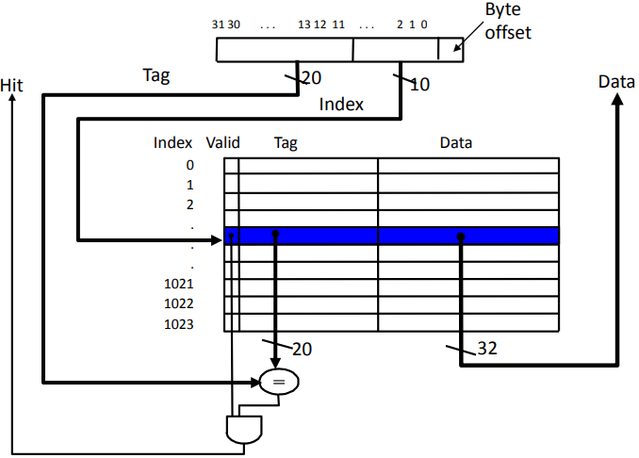
Direct Mapped Cache

Slide 17
Direct Mapped Cache
Example 16 KB direct mapped cache 256-byte blocks
Which of the following addresses conflict with 0x12345678? 0x12345677 0x11335577 0x11115678 0x12341666

Slide 18
Direct Mapped Cache
Example 16 KB direct mapped cache 256-byte blocks
Which of the following addresses conflict with 0x12345678? 0x12345677 0x11335577 0x11115678 0x12341666
be in diff blocks
map to same cache lines

Slide 19
Direct Mapped Cache
Example 16 KB direct mapped cache 256-byte blocks
Which of the following addresses conflict with 0x12345678? 0x12345677 0x11335577 0x11115678 0x12341666
log256=8-bit offset

Slide 20
Direct Mapped Cache
Example 16 KB direct mapped cache 256-byte blocks
Which of the following addresses conflict with 0x12345678? 0x12345677 0x11335577 0x11115678 0x12341666
log(16KB/256B)=64 lines
log64=6-bit line index
part of…

Slide 21
Direct Mapped Cache
Example 16 KB direct mapped cache 256-byte blocks
Which of the following addresses conflict with 0x12345678? 0x12345677 …01010110… 0x11335577 …01010101… 0x11115678 …01010110… 0x12341666 …00010110…
part of…

Slide 22
Direct Mapped Cache
Example 16 KB direct mapped cache 256-byte blocks
Which of the following addresses conflict with 0x12345678? 0x12345677 …01010110… same block 0x11335577 …01010101… diff line 0x11115678 …01010110… conflict 0x12341666 …00010110… conflict
part of…

Slide 23
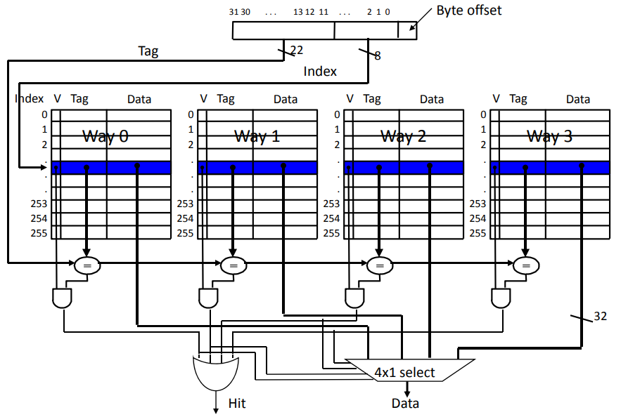
Set Associative Cache

Slide 24
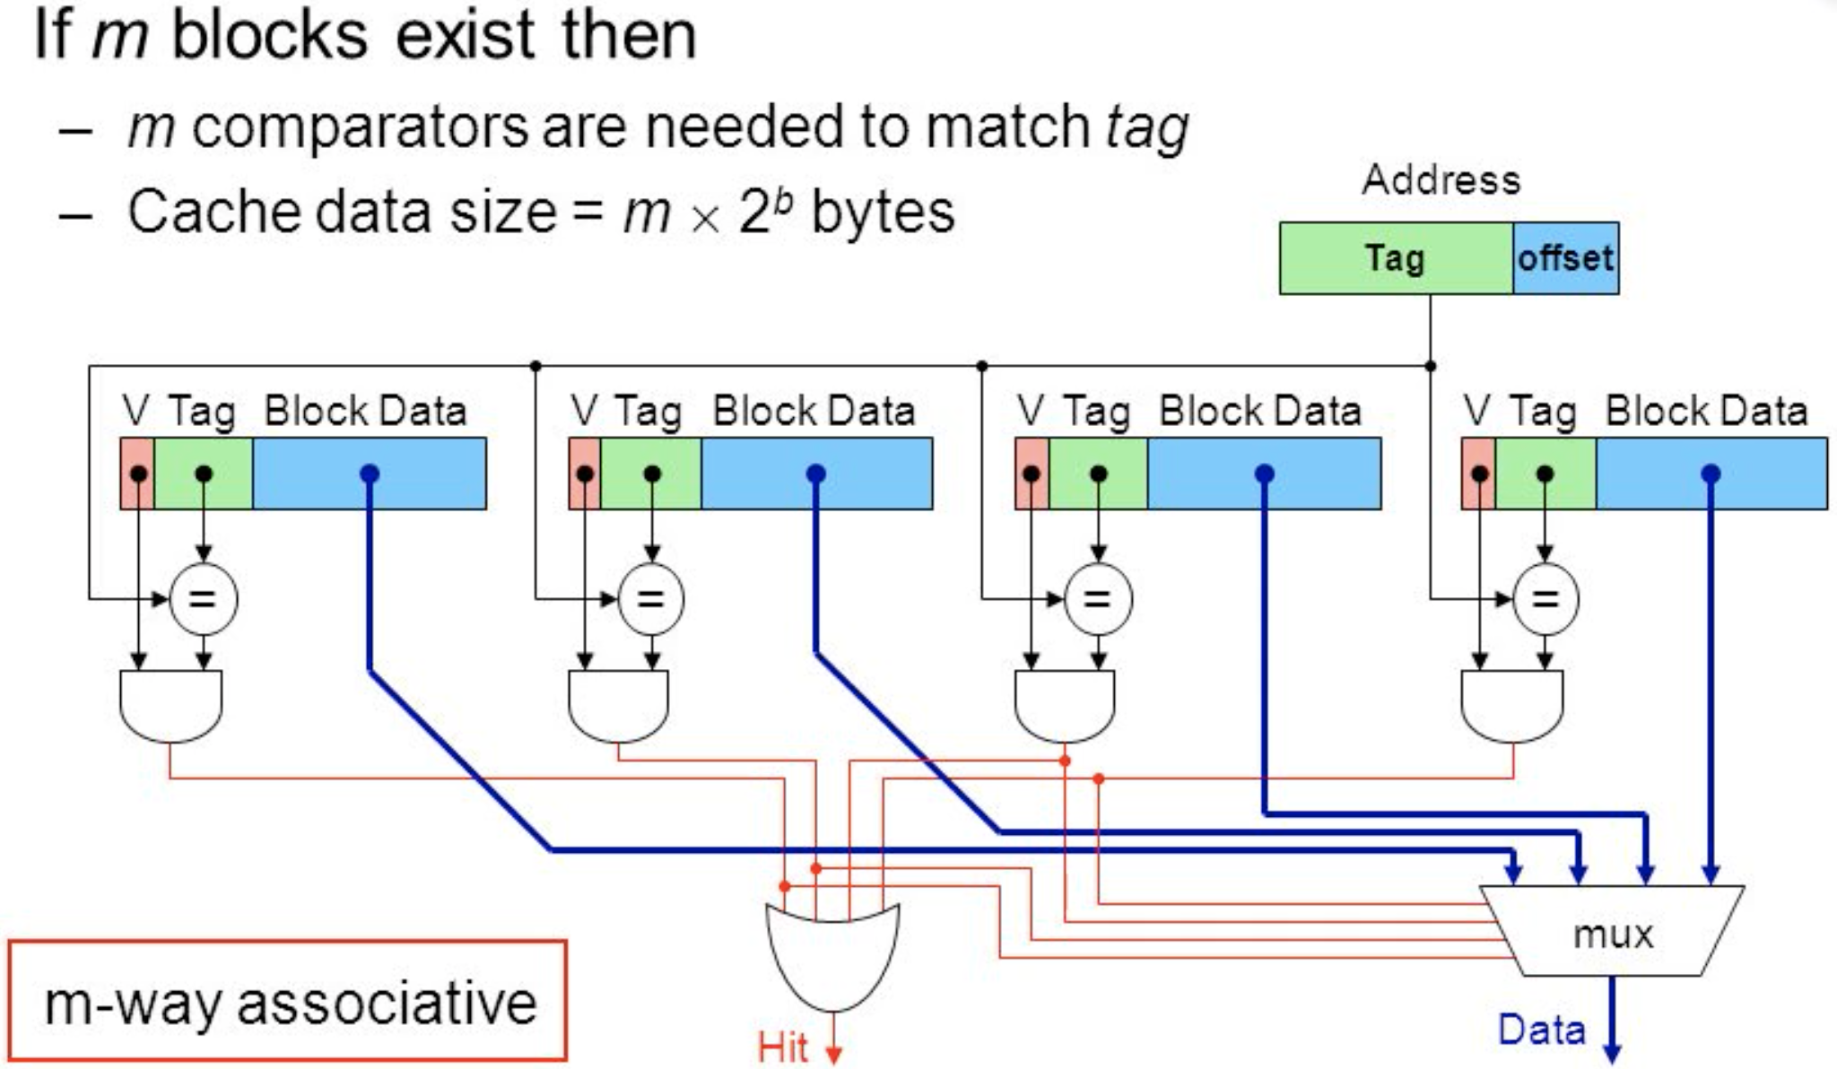
Fully Associative Cache
https://slideplayer.com/slide/9747380/
Notes:
Consider only a single set containing all of the m blocks in the cache

Slide 25
DRAM
Dynamic Random Access Memory
Single transistor per bit
Reading destroys the information
Refresh periodically
cycle time > access time

Slide 26
DRAM
Dynamic Random Access Memory
Single transistor per bit
Reading destroys the information
Refresh periodically
cycle time > access time
DRAMs are commonly sold on small boards called DIMM
(dual inline memory modules),
typically containing 4 ~ 16 DRAMs

Slide 27
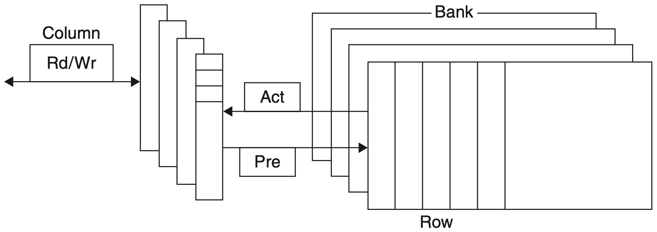
DRAM Organization
DRAMs are organized in banks
Notes:
Figure 2.3 Internal organization of a DRAM. Modern DRAMs are organized in banks, up to 16 for DDR4. Each bank consists of a series of rows. Sending an ACT (Activate) command opens a bank and a row and loads the row into a row buffer. When the row is in the buffer, it can be bbtrbansferred by successive column addresses at whatever the width of the DRAM is (typically 4, 8, or 16 bits in DDR4) or by specifying a block trans- fer and the starting address. The Precharge commend (PRE) closes the bank and row and readies it for a new access. Each command, as well as block transfers, are synchro- nized with a clock. See the next section discussing SDRAM. The row and column signals are sometimes called RAS and CAS, based on the original names of the signals.

Slide 28
DRAM Organization
Each bank consists of a series of rows
RAS: row access strobe

Slide 29
DRAM Organization
Each row consists of a series of columns
CAS: column access strobe

Slide 30
DRAM Organization
Pre (pre.charge) command opens or closes a bank
√

Slide 31
DRAM Organization
Row address is sent with an Act (activate) command;
Then row is transferred to a buffer
√

Slide 32
DRAM Organization
For row in the buffer, it can be transferred by successive column addresses
√

Slide 33
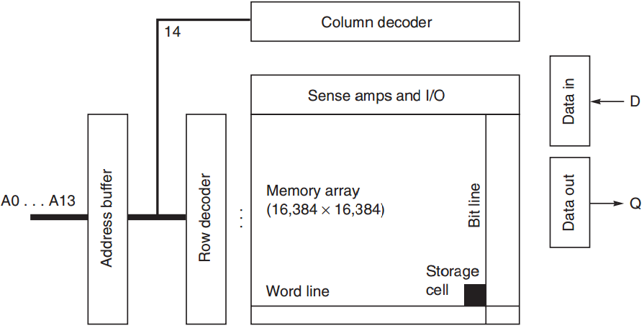
DRAM Organization
Notes:
Could refer to slides here fore more details: https://pubweb.eng.utah.edu/~cs6710/slides/memoryx2.pdf

Slide 34
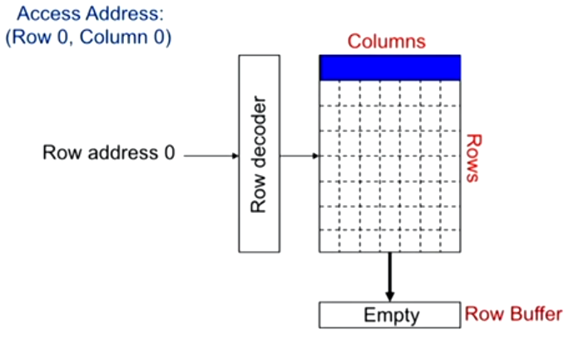
DRAM Access Example

Slide 35
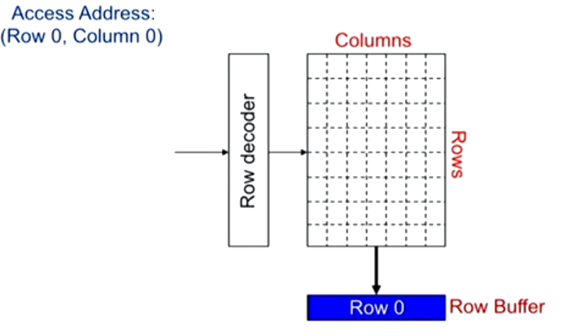
Bring Row into Row Buffer

Slide 36
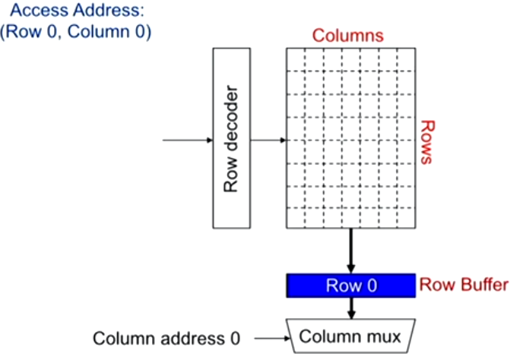
Select Data via Multiplexor

Slide 37
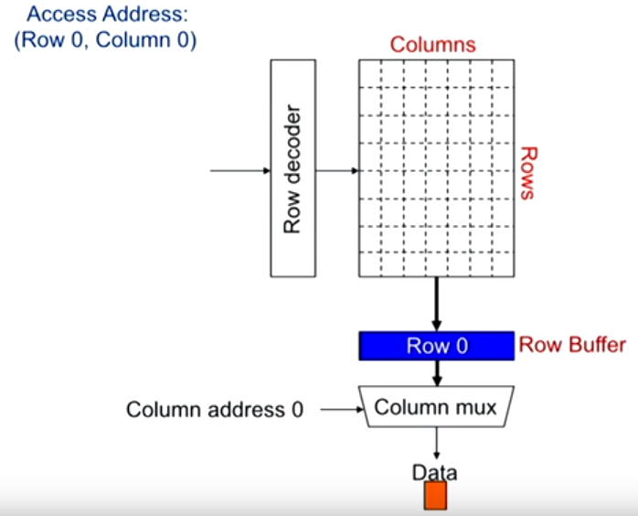
Data Selected

Slide 38
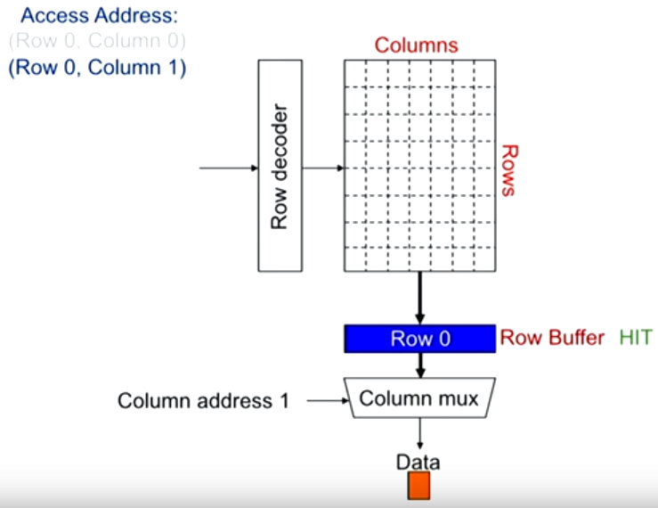
Row Buffer Hit

Slide 39
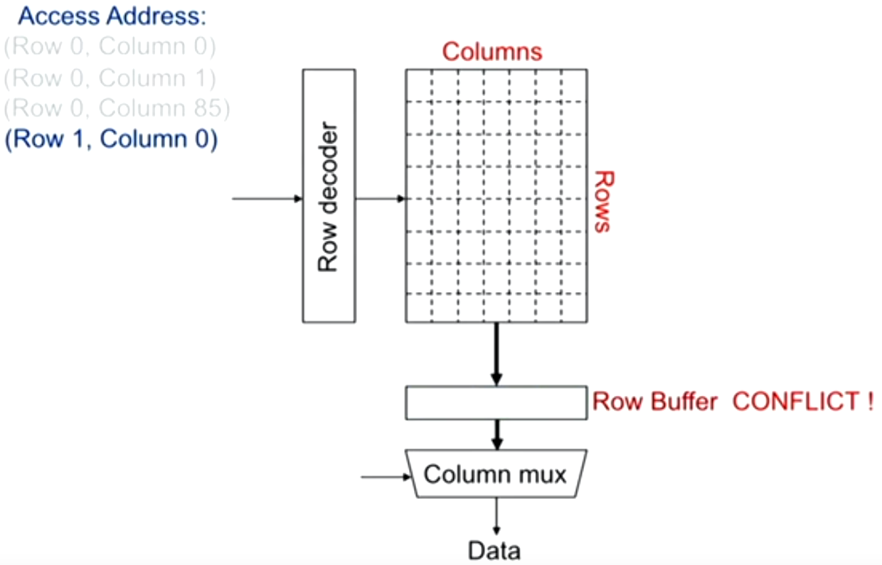
Row Buffer Conflict
Notes:
Row-hit first: service row-hit memory access first
Oldest-first: then service older access first
For maximizing DRAM throughput

Slide 40
DRAM Improvement
Timing signals
allow repeated accesses to the row buffer w/o another row access time;
Leverage spatial locality
each array will buffer 1024 to 4096 bits for each access;

Slide 41
DRAM Improvement
Clock signal
added to the DRAM interface,
so that repeated transfers will not involve overhead to synchronize with memory controller;
SDRAM: synchronous DRAM
Notes:
DRAM interface itself incorporates clock signals and knows when to start a transfer, need not (remotely) sync with the controller

Slide 42
DRAM Improvement
Wider DRAM
widening memory for higher memory bandwidth;
e.g., 4-bit transfer mode up to 16-bit buses

Slide 43
DRAM Improvement
DDR: double data rate
to increase bandwidth,
transfer data on both the rising edge and falling edge of the DRAM clock signal,
thereby doubling the peak data rate;

Slide 44
DRAM Improvement
Multiple Banks
break a single SDRAM into 2~8 banks;
they can operate independently;
Provide some of the advantages of interleaving
Help with power management
Notes:
Interleaving: some blocks work while some not, save power
The addition of banks also reduced power, since only the row in a single bank is read and precharged.

Slide 45
DRAM Improvement
Reducing power consumption in SDRAMs
dynamic power: used in read or write;
static/standby power;
Depend on the operating voltage
Power down mode: entered by telling the DRAM to ignore the clock
disables the SDRAM except for internal automatic refresh;

Slide 46
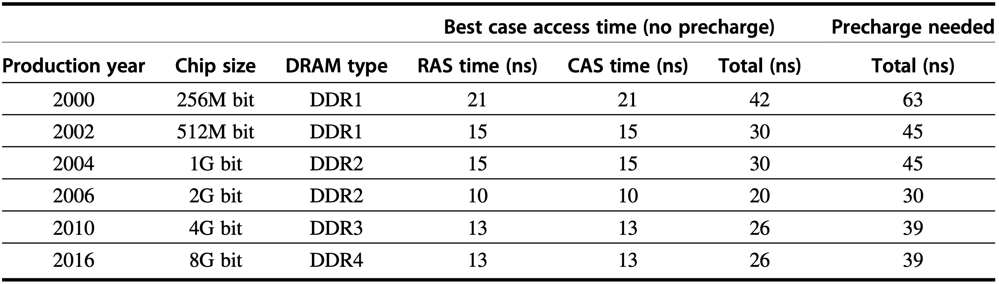
Capacity and Access Time
Notes:
Figure2.4 Capacity and access times for DDR SDRAMs by year of production. Access time is for a random memory word and assumes a new row must be opened. If the row is in a different bank, we assume the bank is precharged; if the row is not open, then a precharge is required, and the access time is longer. As the number of banks has increased, the ability to hide the precharge time has also increased. DDR4 SDRAMs were initially expected in 2014, but did not begin production until early 2016.

Slide 47
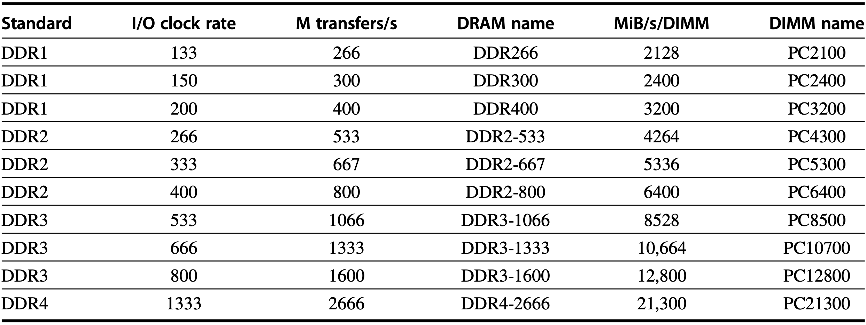
Clock Rates and Bandwidth
Notes:
Figure2.5 Clock rates, bandwidth, and names of DDR DRAMS and DIMMs in 2016. Note the numerical relationship between the columns. The third column is twice the second, and the fourth uses the number from the third column in the name of the DRAM chip. The fifth column is eight times the third column, and a rounded version of this number is used in the name of the DIMM. DDR4 saw significant first use in 2016.
With the introduction of DDR, memory designers increasing focused on band- width, because improvements in access time were difficult. Wider DRAMs, burst transfers, and double data rate all contributed to rapid increases in memory band- width. DRAMs are commonly sold on small boards called dual inline memory modules (DIMMs) that contain 4–16 DRAM chips and that are normally organized to be 8 bytes wide (+ ECC) for desktop and server systems. When DDR SDRAMs are packaged as DIMMs, they are confusingly labeled by the peak DIMM band- width. Therefore the DIMM name PC3200 comes from 200 MHz $ 2 $ 8 bytes, or 3200 MiB/s; it is populated with DDR SDRAM chips. Sustaining the confusion, the chips themselves are labeled with the number of bits per second rather than their clock rate, so a 200 MHz DDR chip is called a DDR400. Figure 2.5 shows the relationships’ I/O clock rate, transfers per second per chip, chip bandwidth, chip name, DIMM bandwidth, and DIMM name.

Slide 48
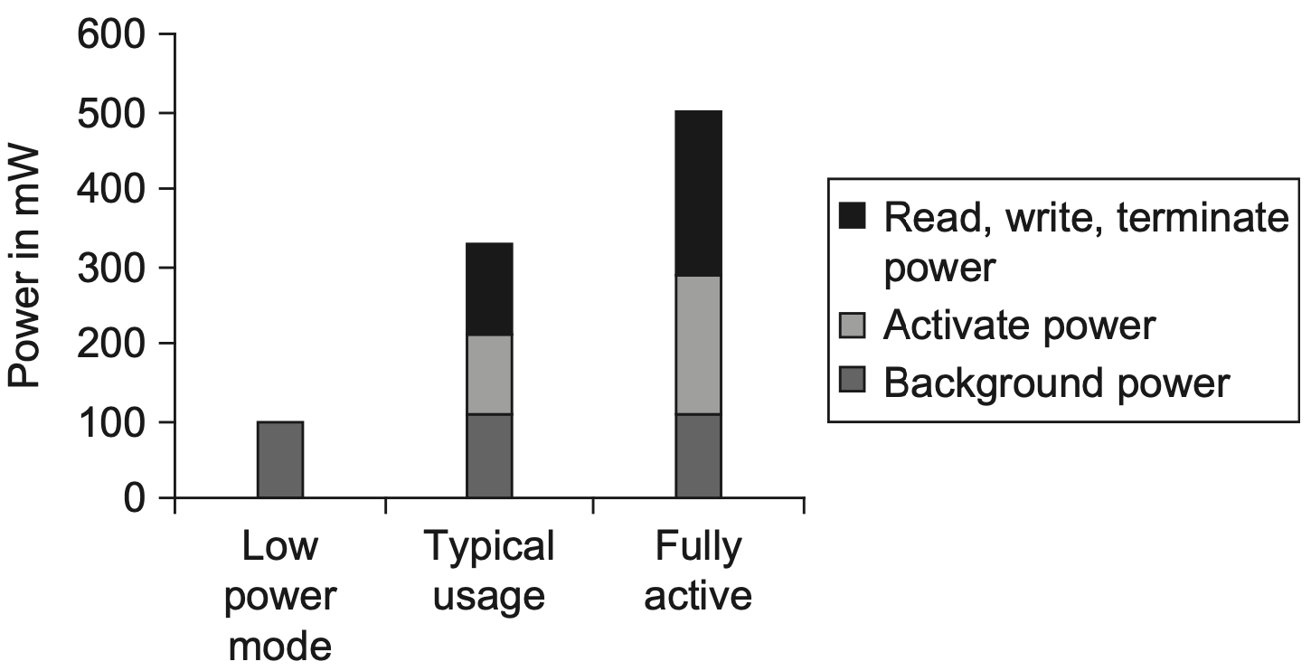
Power Consumption
Notes:
Figure 2.6 Power consumption for a DDR3 SDRAM operating under three condi- tions: low-power (shutdown) mode, typical system mode (DRAM is active 30% of the time for reads and 15% for writes), and fully active mode, where the DRAM is continuously reading or writing. Reads and writes assume bursts of eight transfers. These data are based on a Micron 1.5V 2GB DDR3-1066, although similar savings occur in DDR4 SDRAMs.

Slide 49
Graphics Data RAM
GDRAM: Graphics DRAM
GSDRAM: Graphics Synchronous DRAM
Tailored for higher bandwidth demands of GPUs
Notes:
GDRAMs or GSDRAMs (Graphics or Graphics Synchronous DRAMs) are a spe- cial class of DRAMs based on SDRAM designs but tailored for handling the higher bandwidth demands of graphics processing units. GDDR5 is based on DDR3 with earlier GDDRs based on DDR2. Because graphics processor units (GPUs; see Chapter 4) require more bandwidth per DRAM chip than CPUs, GDDRs have several important differences:

Slide 50
Graphics Data RAM
Wider interfaces
32 bits
Higher maximum clock rate on data pins
GDRAMs directly connect to GPU
and attach to the board
2~5 times the bandwidth per DRAM versus DDR3 DRAMs
Notes:
GDDRs have wider interfaces: 32-bits versus 4, 8, or 16 in current designs.
GDDRs have a higher maximum clock rate on the data pins. To allow a higher transfer rate without incurring signaling problems, GDRAMS normally connect directly to the GPU and are attached by soldering them to the board, unlike DRAMs, which are normally arranged in an expandable array of DIMMs.

Slide 51
Stacked/Embedded DRAM
HBM: High Bandwidth Memory
Packaging innovation, rather than circuit innovation
Place multiple DRAMs in a stacked or adjacent fashion embedded within the same package as the processor

Slide 52
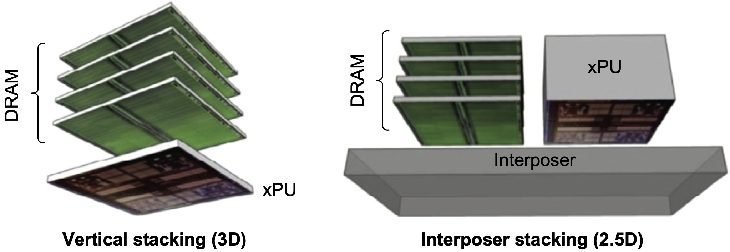
Stacked/Embedded DRAM
Lower access latency
Increase bandwidth by allowing more and faster connections between processor and DRAM
Notes:
Heat management for vertical stacking

Slide 53
Flash Memory
A type of EEPROM (electronically erasable programmable read-only memory)
Read-only but can be erased
Nonvolatile: hold contents w/o any power
Used as main memory for PMD
Notes:
Why flash memory during discussion of main memory:
Flash is used as the backup storage in PMDs in the same manner that a disk functions in a laptop or server. In addition, because most PMDs have a limited amount of DRAM, Flash may also act as a level of the memory hierarchy.

Slide 54
Flash Memory
Differences from DRAM
Must be erased (in blocks) before it is overwritten
Nonvolatile and less power consumption
Has a limited number of write cycles for any block
Cheaper than SDRAM but more expensive than disk
Slower than SDRAM but faster than disk

Slide 55
Flash Memory
Differences from DRAM
Has a limited number of write cycles for any block
Write leveling technique: ensure uniform distribution of written blocks throughout the memory

Slide 56
Phase-Change Memory
Eliminate the need to erase a page before writing
In comparison with NAND
10 times higher write performance
2~3 times lower read latency
In comparison with Flash
2~3 times lower read latency
Suitable for SSD (Solid State Disk)
Notes:
NAND is a type of non-volatile flash memory, meaning it does not require power to retain or store data. Devices such as digital cameras, USB flash drives, smartphones, and SSDs utilize NAND flash memory for storage.

Slide 57
Memory Dependability
Soft errors / Permanent faults
changes to a cell’s contents, not a change in the circuitry
Hard errors / Transient faults
permanent changes in the operation of one or more memory cells
Notes:
Large caches and main memories significantly increase the possibility of errors occurring both during the fabrication process and dynamically during operation. Errors that arise from a change in circuitry and are repeatable are called hard errors or permanent faults. Hard errors can occur during fabrication, as well as from a circuit change during operation (e.g., failure of a Flash memory cell after many writes). All DRAMs, Flash memory, and most SRAMs are manufactured with spare rows so that a small number of manufacturing defects can be accommodated by programming the replacement of a defective row by a spare row. Dynamic errors, which are changes to a cell’s contents, not a change in the circuitry, are called soft errors or transient faults.

Slide 58
Memory Dependability
Error detection and fix
Parity only
only one bit of overhead to detect a single error in a sequence of bits;
e.g., one parity bit per 8 data bits
ECC only
detect two errors and correct a single error with 8-bit overhead per 64 data bits

Slide 59
Memory Dependability
Error detection and fix
Parity only
only one bit of overhead to detect a single error in a sequence of bits;
e.g., one parity bit per 8 data bits
ECC only
detect two errors and correct a single error with 8-bit overhead per 64 data bits
data loss if failure of single mem chip

Slide 60
Memory Dependability
Error detection and fix
Chipkill
similar to RAID, distribute data and ECC across multiple memory chips;
handle multiple errors and complete failure of a single memory chip;
Notes:
Similar in nature to the RAID approach used for disks, Chipkill distributes the data and ECC information, so that the complete failure of a single mem- ory chip can be handled by supporting the reconstruction of the missing data from the remaining memory chips.

Slide 61
Memory Dependability
10000-processor server w/ 4 GiB/processor:
Rates of unrecoverable errors in 3 yrs
Parity only
about 90,000, or one unrecoverable (undetected) failure every 17 mins
ECC only
about 3,500 or about one undetected or unrecoverable failure every 7.5 hrs
Chipkill
about one undetected or unrecoverable failure every 2 months

Slide 62
Optimization
√
Notes:
So now we discuss a lot of tricks to optimize memory performance
Chapter 2.2

Slide 63
Optimization
?
Notes:
still remember cache, another important part in the mem hierarchy, right?
so, the question, is how to optimize cache performance?

Slide 64
Cache Performance
Average Memory Access Time = Hit Time + Miss Rate x Miss Penalty
(1 – Miss Rate) x Hit Time + Miss Rate x Miss Time
Notes:
The key metric to measure cache performance is average memory access time,
which is further determined by three other metrics:
Hit time, miss rate, and miss penalty.
Clearly, reducing any of these metrics could reduce average memory access time and thus enhance cache performance.

Slide 65
Cache Performance
Average Memory Access Time = Hit Time + Miss Rate x Miss Penalty
(1 – Miss Rate) x Hit Time + Miss Rate x (Hit Time + Miss Penalty)
Notes:
The key metric to measure cache performance is average memory access time,
which is further determined by three other metrics:
Hit time, miss rate, and miss penalty.
Clearly, reducing any of these metrics could reduce average memory access time and thus enhance cache performance.

Slide 66
Cache Performance
Average Memory Access Time = Hit Time + Miss Rate x Miss Penalty
Notes:
The key metric to measure cache performance is average memory access time,
which is further determined by three other metrics:
Hit time, miss rate, and miss penalty.
Clearly, reducing any of these metrics could reduce average memory access time and thus enhance cache performance.

Slide 67
six basic optimizations
Notes:
Now let’s recap the six basic optimizations we previously discussed.
Chapter 1.1 & Appendix B.3

Slide 68
Six Basic Cache Optimizations
1. larger block size
reduce miss rate; --- spatial locality;
reduce static power; --- lower tag #;
increase miss penalty, capacity/conflict misses;
2. bigger caches
reduce miss rate; --- capacity misses
increase hit time;
increase cost and (static & dynamic) power;
3. higher associativity
reduce miss rate; --- of conflict misses;
increase hit time;
increase power;
Notes:
Static power: leakage when not operating
Dynamic power; when performing a read or write

Slide 69
Six Basic Cache Optimizations
4. multilevel caches
reduce miss penalty;
reduce power;
average memory access time =
Hit time_{L1} + Miss rate_{L1} x
(Hit time_{L2} + Miss rate_{L2} x Miss penalty_{L2})
5. giving priority to read misses over writes
reduce miss penalty;
introduce write buffer;
Notes:
Giving priority to read misses over writes to reduce miss penalty—A write buffer is a good place to implement this optimization. Write buffers create hazards because they hold the updated value of a location needed on a read
miss—that is, a read-after-write hazard through memory. One solution is to check the contents of the write buffer on a read miss. If there are no conflicts, and if the memory system is available, sending the read before the writes reduces the miss penalty. Most processors give reads priority over writes. This choice has little effect on power consumption.

Slide 70
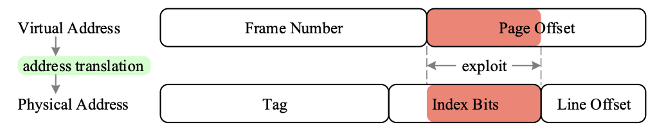
Six Basic Cache Optimizations
6. avoiding address translation during indexing of the cache
reduce hit time;
use page offset to index cache;
virtually indexed, physically tagged;
(indexing cache while querying TLB)
Notes:
Avoiding address translation during indexing of the cache to reduce hit time—Caches must cope with the translation of a virtual address from the processor to a physical address to access memory. (Virtual memory is cov- ered in Sections 2.4 and B.4.) A common optimization is to use the page offset—the part that is identical in both virtual and physical addresses—to index the cache, as described in Appendix B, page B-38. This virtual index/ physical tag method introduces some system complications and/or
limitations on the size and structure of the L1 cache, but the advantages of removing the translation lookaside buffer (TLB) access from the critical path outweigh the disadvantages.

Slide 71
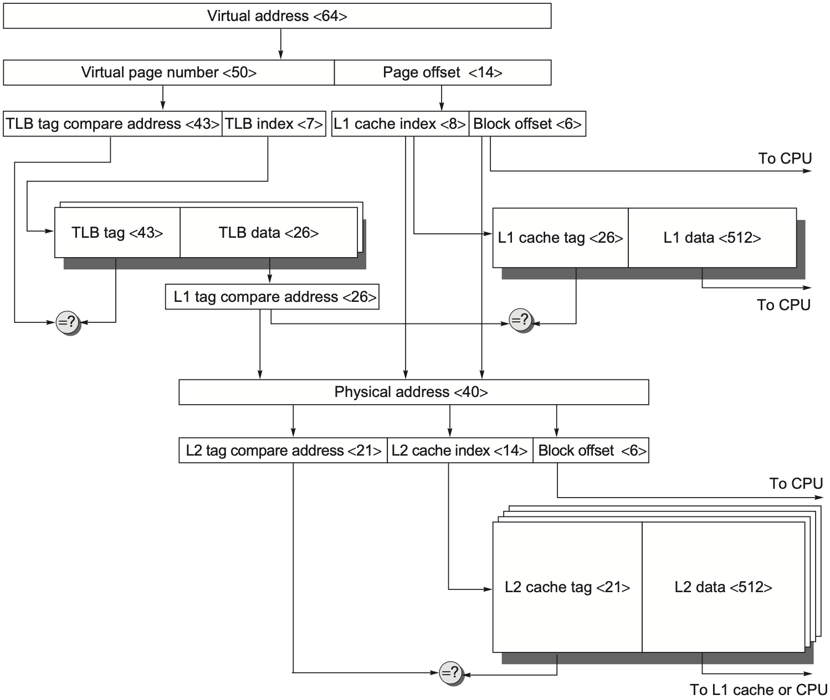
Address Translation
64-bit virtual address
40-bit physical address
page size: 16 KiB
two-level caches
64-byte blocks
direct-mapped L1: 16 KiB
4-way set associative L2: 4 MiB
2-way set associative TLB: 256 entries
Notes:
Figure B.17 The overall picture of a hypothetical memory hierarchy going from virtual address to L2 cache access. The page size is 16 KiB. The TLB is two-way set associative with 256 entries. The L1 cache is a direct-mapped 16 KiB, and the L2 cache is a four-way set associative with a total of 4 MiB. Both use 64-byte blocks. The virtual address is 64 bits and the physical address is 40 bits.

Slide 72
Average Memory Access Time = Hit Time + Miss Rate x Miss Penalty
Larger block size;
Larger cache size;
Higher associativity;

Slide 73
Root Causes of Miss Rates
Compulsory:
cold-start/first-reference misses;
Capacity
cache size limit;
blocks discarded and later retrieved;
Conflict
collision misses: associativity
direct mapped or set associative cache;
a block discarded and later retrieved in a set;
Notes:
To gain better insights into the causes of misses, we first start with a model that sorts all misses into three simple categories
Compulsory—The very first access to a block cannot be in the cache, so the block must be brought into the cache. These are also called cold-start misses or first-reference misses. (would be a cache miss even in an infinite cache)
Capacity—If the cache cannot contain all the blocks needed during execution of a program, capacity misses (in addition to compulsory misses) will occur because of blocks being discarded and later retrieved. (would be a cache miss even in a fully associative cache)
Conflict—If the block placement strategy is set associative or direct mapped, conflict misses (in addition to compulsory and capacity misses) will occur because a block may be discarded and later retrieved if too many blocks map to its set. These misses are also called collision misses. The idea is that hits in a fully associative cache that become misses in an n-way set-associative cache are due to more than n requests on some popular sets. (would not be a cache miss in a fully associative cache)
Having identified the three C’s, what can a computer designer do about them? Conceptually, conflicts are the easiest: Fully associative placement avoids all conflict misses. Full associativity is expensive in hardware, however, and may slow the processor clock rate (see the example on page B-29), leading to lower overall performance.

Slide 74
Capacity vs Conflict
Capacity misses occur upon the cache is full
Not necessarily for conlict misses to take place
Conflict misses can occur without the cache being fully occupied
Notes:
Key difference between capacity misses and conflict misses

Slide 75
Opt #1: Larger Block Size
Reduce compulsory misses
Leverage spatial locality
Increase conflict/capacity misses
Fewer blocks in the cache
Larger blocks increase miss penalty
Notes:
Larger block sizes will reduce also compulsory misses. This reduction occurs because the principle of locality has two components: temporal locality and spatial locality. Larger blocks take advantage of spatial locality.
At the same time, larger blocks increase the miss penalty. Since they reduce the number of blocks in the cache, larger blocks may increase conflict misses and even capacity misses if the cache is small. Clearly, there is little reason to increase the block size to such a size that it increases the miss rate. There is also no benefit to reducing miss rate if it increases the average memory access time. The increase in miss penalty may outweigh the decrease in miss rate.

Slide 76
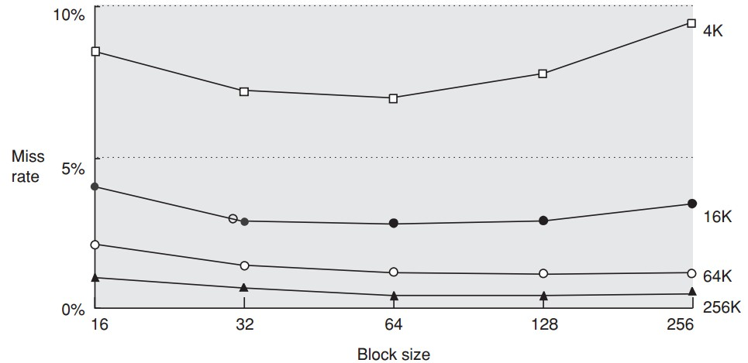
Opt #1: Larger Block Size
Notes:
shows the trade-off of block size versus miss rate for a set of programs and cache sizes.

Slide 77
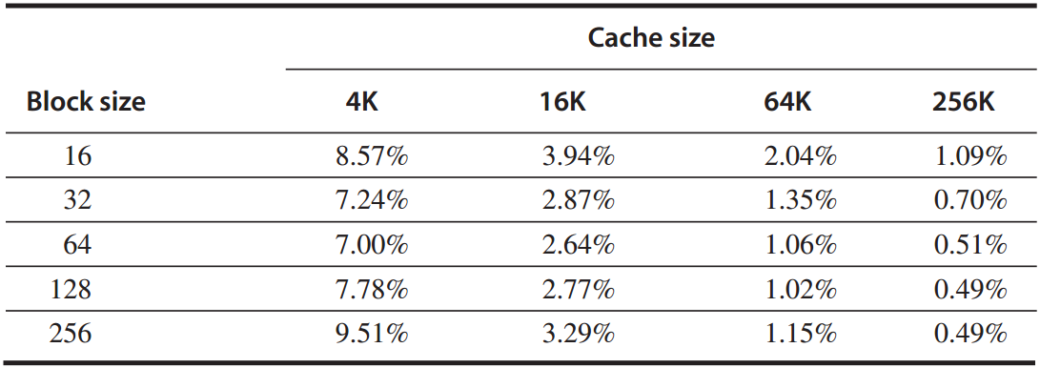
Opt #1: Larger Block Size
given the above miss rates;
assume memory takes 80 CC overhead,
delivers 16 bytes in 2 CC;
Q: which block size has the smallest average memory access time for each cache size?

Slide 78
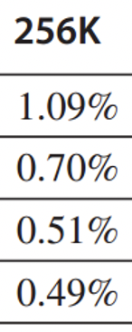
Opt #1: Larger Block Size
byte
Answer
avg mem access time
=hit time + miss rate x miss penalty
*assume 1-CC hit time
for a 256-byte block in a 256 KB cache:
avg mem access time
= 1 + 0.49% x [80 + 2x(256/16)]
= 1.5 cc

Slide 79
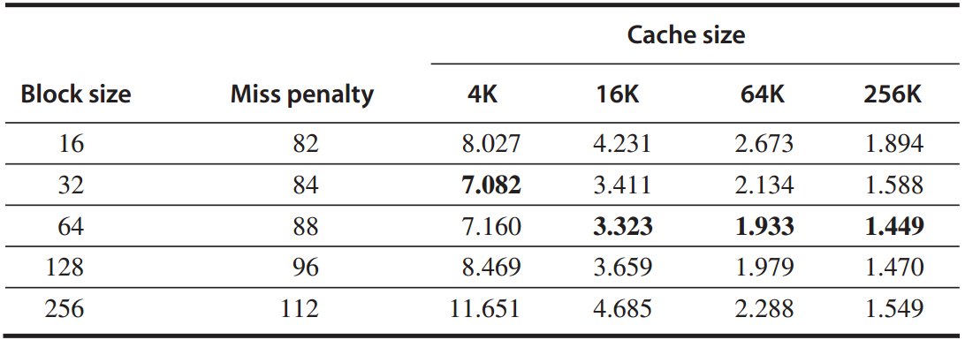
Opt #1: Larger Block Size
Answer
average memory access time
Notes:
Figure B.12 shows the average memory access time for all block and cache sizes between those two extremes. The boldfaced entries show the fastest block size for a given cache size: 32 bytes for 4 KB and 64 bytes for the larger caches. These sizes are, in fact, popular block sizes for processor caches today.
As in all of these techniques, the cache designer is trying to minimize both the miss rate and the miss penalty. The selection of block size depends on both the latency and bandwidth of the lower-level memory. High latency and high bandwidth encourage large block size since the cache gets many more bytes per miss for a small increase in miss penalty. Conversely, low latency and low band- width encourage smaller block sizes since there is little time saved from a larger block. For example, twice the miss penalty of a small block may be close to the penalty of a block twice the size. The larger number of small blocks may also reduce conflict misses.

Slide 80
Opt #2: Larger Cache
Reduce capacity misses
Increase hit time, cost, and power

Slide 81
Opt #3: Higher Associativity
Reduce conflict misses
Increase hit time

Slide 82
Opt #3: Higher Associativity
Reduce conflict misses
Increase hit time
2:1 cache rule of thumb:
a direct-mapped cache of size N
has about the same miss rate
as a two-way set associative cache of
size N/2
Notes:
2:1 cache rule of thumb: demonstrate benefits of associativity for decreasing miss rates
However, higher-associativity increases hit time and therefore may increase memory access time for larger caches

Slide 83
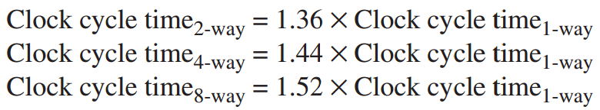
Opt #3: Higher Associativity
Example
assume higher associativity -> higher clock cycle time:
assume 1-cc hit time,
25-cc miss penalty,
and miss rates in the following table:

Slide 84
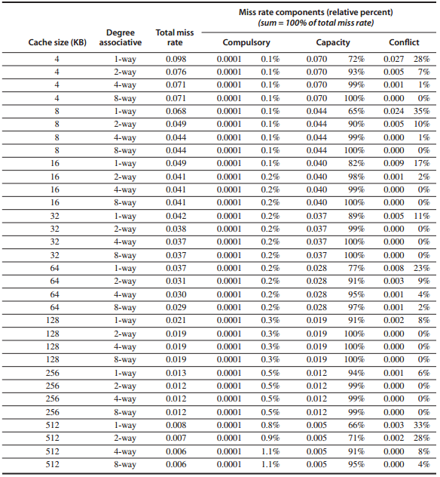
Miss rates

Slide 85
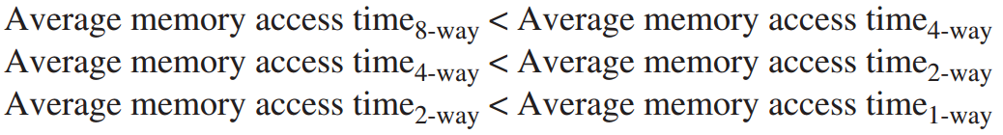
Opt #3: Higher Associativity
Question:
for which cache sizes
are each of the statements true?

Slide 86
Opt #3: Higher Associativity
Answer
example, for a 512 KB, 8-way set associative cache:
avg mem access time
=hit time + miss rate x miss penalty
=1.52x1 + 0.006 x 25
=1.66

Slide 87
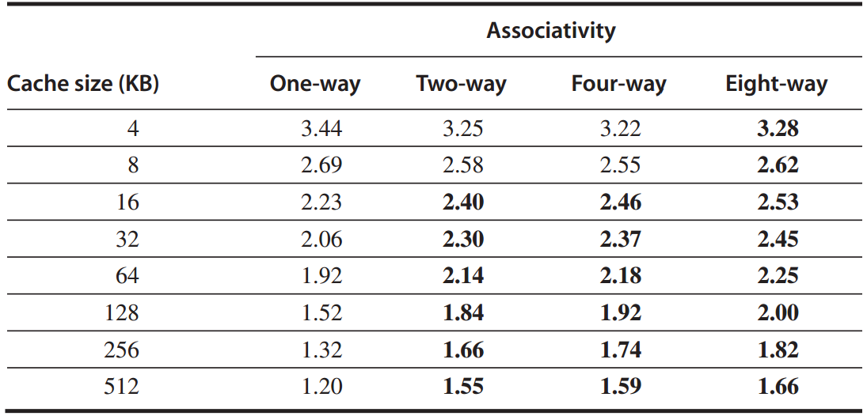
Opt #3: Higher Associativity
Answer
average memory access time

Slide 88
Average Memory Access Time = Hit Time + Miss Rate x Miss Penalty
Multilevel caches;
Reads > Writes;
Notes:
Reducing cache misses had been the traditional focus of cache research, but the cache performance formula assures us that improvements in miss penalty can be just as beneficial as improvements in miss rate.

Slide 89
Opt #4: Multilevel Cache
Reduce miss penalty
Motivation
faster/smaller cache to keep pace with the speed of processors?
larger cache to overcome the widening gap between processor and main mem?

Slide 90
Opt #4: Multilevel Cache
Reduce miss penalty
Motivation
faster/smaller cache to keep pace with the speed of processors?
larger cache to overcome the widening gap between processor and main mem?
do both
Notes:
Xhzczxzt, wqdy

Slide 91
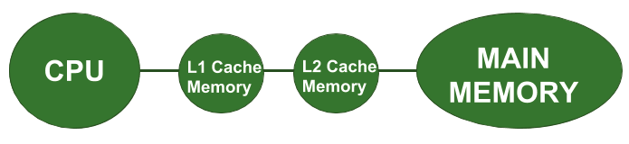
Opt #4: Multilevel Cache
Two-level cache
Add another level of cache between the original cache and memory

Slide 92
Opt #4: Multilevel Cache
Two-level cache
Add another level of cache between the original cache and memory
L1: small enough to match the clock cycle time of the fast processor;
L2: large enough to capture many accesses that would go to main memory, lessening miss penalty

Slide 93
Opt #4: Multilevel Cache
Average memory access time
=Hit time_{L1} + Miss rate_{L1} x Miss penalty_{L1}
=Hit time_{L1} + Miss rate_{L1}
x(Hit time_{L2}+Miss rate_{L2}xMiss penalty_{L2})
Average mem stalls per instruction
=Misses per instruction_{L1} x Hit time_{L2}
+ Misses per instr_{L2} x Miss penalty_{L2}

Slide 94
Opt #4: Multilevel Cache
Average memory access time
=Hit time_{L1} + Miss rate_{L1} x Miss penalty_{L1}
=Hit time_{L1} + Miss rate_{L1}
x(Hit time_{L2}+Miss rate_{L2}xMiss penalty_{L2})
Average mem stalls per instruction
=Misses per instruction_{L1} x Hit time_{L2}
+ Misses per instr_{L2} x Miss penalty_{L2}

Slide 95
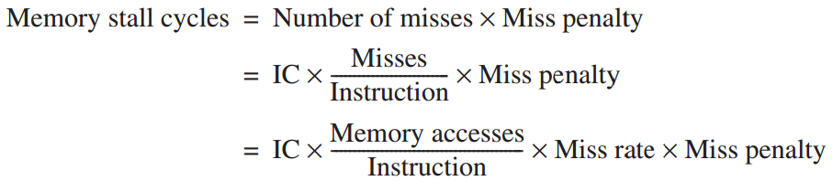
(recap) Cache Performance: Equations!!!
Assumption:
Includes the time
to handle
a cache hit/miss

Slide 96
Opt #4: Multilevel Cache
Local miss rate
the number of misses in a cache
divided by the total number of mem accesses to this cache;
Miss rate_{L1}, Miss rate_{L2}
Global miss rate
the number of misses in the cache
divided by the number of mem accesses generated by the processor;
Miss rate_{L1}, Miss rate_{L1} x Miss rate_{L2}
Notes:
Local miss rate—This rate is simply the number of misses in a cache divided by the total number of memory accesses to this cache. As you would expect, for the first-level cache it is equal to Miss rateL1, and for the second-level cache it is Miss rateL2.
Global miss rate—The number of misses in the cache divided by the total number of memory accesses generated by the processor. Using the terms above, the global miss rate for the first-level cache is still just Miss rateL1, but for the second-level cache it is Miss rateL1 × Miss rateL2.

Slide 97
Opt #4: Multilevel Cache
Local miss rate
the number of misses in a cache
divided by the total number of mem accesses to this cache;
Miss rate_{L1}, Miss rate_{L2}
Global miss rate
the number of misses in the cache
divided by the number of mem accesses generated by the processor;
Miss rate_{L1}, Miss rate_{L1} x Miss rate_{L2}
L1x Mrate_{L2} / all
=(L1/all) x Mrate_{L2}
=Mrate_{L1} x Mrate_{L2}
Notes:
Local miss rate—This rate is simply the number of misses in a cache divided by the total number of memory accesses to this cache. As you would expect, for the first-level cache it is equal to Miss rateL1, and for the second-level cache it is Miss rateL2.
Global miss rate—The number of misses in the cache divided by the total number of memory accesses generated by the processor. Using the terms above, the global miss rate for the first-level cache is still just Miss rateL1, but for the second-level cache it is Miss rateL1 × Miss rateL2.

Slide 98
Opt #4: Multilevel Cache
Multilevel inclusion
L1 data always present in L2;
ease consistency checking by targeting
only L2 cache;
Multilevel exclusion
for L2 slightly bigger than L1,
L1 data are never found in L2;
L1 miss results in a swap of blocks
between L1 and L2;
Notes:
Another consideration concerns whether data in the first-level cache are in the second-level cache. Multilevel inclusion is the natural policy for memory hierarchies: L1 data are always present in L2. Inclusion is desirable because con- sistency between I/O and caches (or among caches in a multiprocessor) can be determined just by checking the second-level cache.
However, what if the designer can only afford an L2 cache that is slightly big- ger than the L1 cache? Should a significant portion of its space be used as a redundant copy of the L1 cache? In such cases a sensible opposite policy is mul- tilevel exclusion: L1 data are never found in an L2 cache. Typically, with exclu- sion a cache miss in L1 results in a swap of blocks between L1 and L2 instead of a replacement of an L1 block with an L2 block. This policy prevents wasting space in the L2 cache.

Slide 99
Opt #4: Multilevel Cache
Example
1000 mem references -> 40 misses in L1 and 20 misses in L2;
miss penalty from L2 is 200 cc;
hit time of L2 is 10 cc;
hit time of L1 is 1 cc;
1.5 mem references per instruction;
Q: 1. various miss rates?
2. avg mem access time?
3. avg stall cycles per instruction?

Slide 100
Opt #4: Multilevel Cache
Answer
1. various miss rates?
L1: local = global
40/1000 = 4%
L2:
local: 20/40 = 50%
global: 20/1000 = 2%

Slide 101
Opt #4: Multilevel Cache
Answer
2. avg mem access time?
average memory access time
=Hit time_{L1} + Miss rate_{L1}
x(Hit time_{L2}+Miss rate_{L2}xMiss penalty_{L2})
=1 + 4% x (10 + 50% x 200)
=5.4

Slide 102
Opt #4: Multilevel Cache
Answer
3. avg stall cycles per instruction?
average stall cycles per instruction
=Misses per instruction_{L1} x Hit time_{L2}
+ Misses per instr_{L2} x Miss penalty_{L2}
=(1.5x40/1000)x10+(1.5x20/1000)x200
=6.6

Slide 103
Opt #5: Prioritize Read Misses Over Writes
Reduce miss penalty
not simply stall read miss until write buffer empties,
check the contents of write buffer,
let the read miss continue
if no conflicts with write buffer & memory system is available
Notes:
Subsequent reads could be served from the write buffer.
https://en.wikipedia.org/wiki/Write_buffer

Slide 104
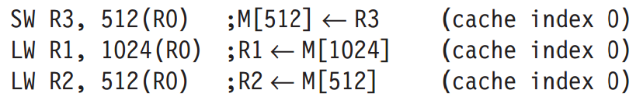
Opt #5: Prioritize Read Misses Over Writes
Why
for the code sequence, assume a direct-mapped, write-through cache that maps 512 and 1024 to the same block;
a four-word write buffer is not checked on a read miss.
R2.value ≡ R3.value ?
*read-after-write data hazard
Notes:
Why check the write buffer?
Read-after-write data hazar
Using the terminology from Chapter 2, this is a read-after-write data hazard in memory. Let’s follow a cache access to see the danger. The data in R3 are placed into the write buffer after the store. The following load uses the same cache index and is therefore a miss. The second load instruction tries to put the value in location 512 into register R2; this also results in a miss. If the write buffer hasn’t completed writing to location 512 in memory, the read of location 512 will put the old, wrong value into the cache block, and then into R2. Without proper pre- cautions, R3 would not be equal to R2!

Slide 105
Average Memory Access Time = Hit Time + Miss Rate x Miss Penalty
Avoid address translation
during indexing of the cache
Notes:
Now that we have five optimizations that reduce cache miss penalties or miss rates, it is time to look at reducing the final component of average memory access time. Hit time is critical because it can affect the clock rate of the processor; in many processors today the cache access time limits the clock cycle rate, even for processors that take multiple clock cycles to access the cache. Hence, a fast hit time is multiplied in importance beyond the average memory access time formula because it helps everything.

Slide 106
Opt #6: Avoid Address Translation During Indexing Cache
Cache addressing
virtual address – virtual cache
physical address – physical cache
Processor/program – virtual address
Processor -> address translation -> Cache
virtual cache or physical cache?

Slide 107
Opt #6: Avoid Address Translation During Indexing Cache
Virtually indexed, physically tagged
page offset to index the cache;
physical address for tag match;
For direct-mapped cache,
it cannot be bigger than the page size.
Reference: CPU Cache
http://zh.wikipedia.org/wiki/CPU%E9%AB%98%E9%80%9F%E7%BC%93%E5%AD%98
*more in later lectures
Notes:
To be covered in later lectures.
One alternative to get the best of both virtual and physical caches is to use part of the page offset—the part that is identical in both virtual and physical addresses—to index the cache. At the same time as the cache is being read using that index, the virtual part of the address is translated, and the tag match uses physical addresses.
This alternative allows the cache read to begin immediately, and yet the tag comparison is still with physical addresses. The limitation of this virtually indexed, physically tagged alternative is that a direct-mapped cache can be no bigger than the page size. For example, in the data cache in Figure B.5 on page B-13, the index is 9 bits and the cache block offset is 6 bits. To use this trick, the virtual page size would have to be at least 2(9+6) bytes or 32 KB. If not, a portion of the index must be translated from virtual to physical address. Figure B.17 shows the organization of the caches, translation lookaside buffers (TLBs), and virtual memory when this technique is used.

Slide 108
Opt #6: Avoid Address Translation During Indexing Cache
Virtually indexed, physically tagged
page offset to index the cache;
physical address for tag match;
For direct-mapped cache,
it cannot be bigger than the page size???
Reference: CPU Cache
http://zh.wikipedia.org/wiki/CPU%E9%AB%98%E9%80%9F%E7%BC%93%E5%AD%98
*more in later lectures
Notes:
To be covered in later lectures.
One alternative to get the best of both virtual and physical caches is to use part of the page offset—the part that is identical in both virtual and physical addresses—to index the cache. At the same time as the cache is being read using that index, the virtual part of the address is translated, and the tag match uses physical addresses.
This alternative allows the cache read to begin immediately, and yet the tag comparison is still with physical addresses. The limitation of this virtually indexed, physically tagged alternative is that a direct-mapped cache can be no bigger than the page size. For example, in the data cache in Figure B.5 on page B-13, the index is 9 bits and the cache block offset is 6 bits. To use this trick, the virtual page size would have to be at least 2(9+6) bytes or 32 KB. If not, a portion of the index must be translated from virtual to physical address. Figure B.17 shows the organization of the caches, translation lookaside buffers (TLBs), and virtual memory when this technique is used.

Slide 109
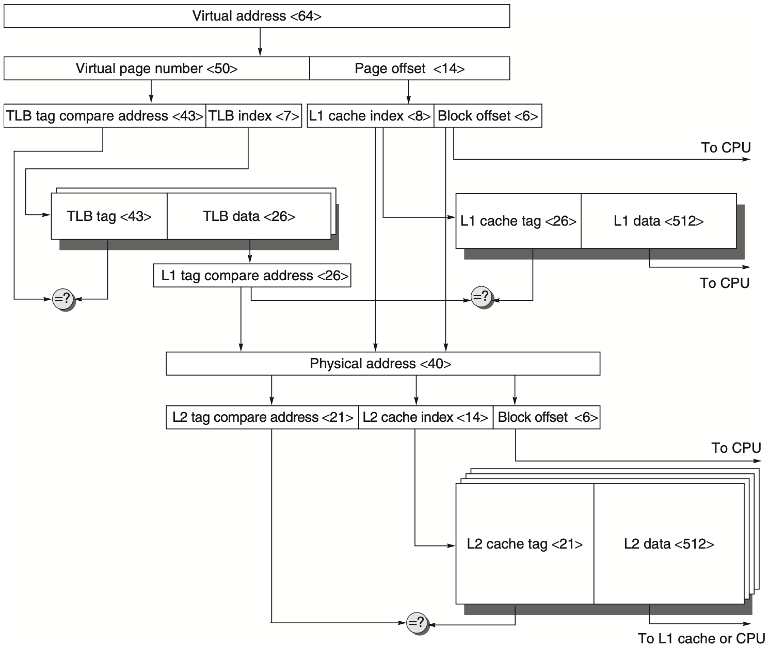
virtual address = virtual page number + page offset
physical address = tag + set index + block offset
_{size of direct-mapped cache:}
₂^{|set index|} _{x 2}^{|block offset|}
_{physically tagged}
_{virtually indexed}
Notes:
To be covered in later lectures.
One alternative to get the best of both virtual and physical caches is to use part of the page offset—the part that is identical in both virtual and physical addresses—to index the cache. At the same time as the cache is being read using that index, the virtual part of the address is translated, and the tag match uses physical addresses.
This alternative allows the cache read to begin immediately, and yet the tag comparison is still with physical addresses. The limitation of this virtually indexed, physically tagged alternative is that a direct-mapped cache can be no bigger than the page size. For example, in the data cache in Figure B.5 on page B-13, the index is 9 bits and the cache block offset is 6 bits. To use this trick, the virtual page size would have to be at least 2(9+6) bytes or 32 KB. If not, a portion of the index must be translated from virtual to physical address. Figure B.17 shows the organization of the caches, translation lookaside buffers (TLBs), and virtual memory when this technique is used.

Slide 110
virtual address = virtual page number + page offset
physical address = tag + set index + block offset
_{size of direct-mapped cache:}
₂^{|set index|} _{x 2}^{|block offset|}
If no translation for virtually indexed
page offset should cover at least both set index and block offset of direct-mapped cache address
_{➔ page size >= cache size}
_{physically tagged}
_{virtually indexed}
Notes:
To be covered in later lectures.
One alternative to get the best of both virtual and physical caches is to use part of the page offset—the part that is identical in both virtual and physical addresses—to index the cache. At the same time as the cache is being read using that index, the virtual part of the address is translated, and the tag match uses physical addresses.
This alternative allows the cache read to begin immediately, and yet the tag comparison is still with physical addresses. The limitation of this virtually indexed, physically tagged alternative is that a direct-mapped cache can be no bigger than the page size. For example, in the data cache in Figure B.5 on page B-13, the index is 9 bits and the cache block offset is 6 bits. To use this trick, the virtual page size would have to be at least 2(9+6) bytes or 32 KB. If not, a portion of the index must be translated from virtual to physical address. Figure B.17 shows the organization of the caches, translation lookaside buffers (TLBs), and virtual memory when this technique is used.

Slide 111
How virtual memory works?
Four Questions
Notes:
Based on these basics of virtual memory,
Now let’s discuss how exactly virtual memory works.

Slide 112
How virtual memory works?
Four Questions
Notes:
In particular, we’ll walk through its working principles via investigating four questions.

Slide 113
Four Mem Hierarchy Q’s
Q1. Where to place a block?
Fully associative strategy:
OS allows blocks to be placed anywhere in main memory
Because of high miss penalty by
access to a rotating magnetic storage device upon page/address fault
Notes:
The first question, block placement in memory.
Still remember block placement strategies when we discussed about cache?
For memory, block placement is fully associative, that is, the OS allows blocks to be placed anywhere in the memory.
The main reason is to load as more blocks as possible to memory, as access to a rotating disk upon memory miss causes high miss penalty.

Slide 114
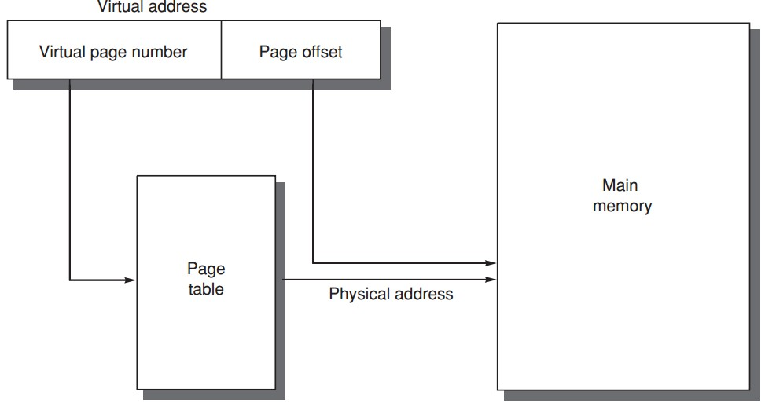
Four Mem Hierarchy Q’s
Q2. How to find a block?
table
entry
VPN PPN
PPN
offset
Notes:
So now a block could be placed anywhere in the memory, given a virtual address, how can we find the exact corresponding physical address?
The solution is using page table to track the mapping between virtual address and physical address.
Specifically, each entry of the page table records which physical page a virtual page maps to.
Then using the offset contained in virtual address, we can locate the exact data within the physical page.

Slide 115
Four Mem Hierarchy Q’s
Q2. How to find a block?
Access memory twice: one for accessing PTE address one for accessing data using phy addr
Cache/Memory
MMU
2. PTEA
CPU
1. VA
3. PTE
4. PA
5. Data
Notes:
So now a block could be placed anywhere in the memory, given a virtual address, how can we find the exact corresponding physical address?
The solution is using page table to track the mapping between virtual address and physical address.
Specifically, each entry of the page table records which physical page a virtual page maps to.
Then using the offset contained in virtual address, we can locate the exact data within the physical page.

Slide 116
Four Mem Hierarchy Q’s
Q2. How to find a block?
table
entry
VPN PPN
PPN
offset
What if vpn->ppn is not found (valid bit)?
Page fault (similar to cahe miss);
Fetch page from disk to memory, update page table, and re-query;
Notes:
So now a block could be placed anywhere in the memory, given a virtual address, how can we find the exact corresponding physical address?
The solution is using page table to track the mapping between virtual address and physical address.
Specifically, each entry of the page table records which physical page a virtual page maps to.
Then using the offset contained in virtual address, we can locate the exact data within the physical page.

Slide 117
Four Mem Hierarchy Q’s
Q2. How to find a block?
Processing a page fault
Page Fault Handler
4. Exception
Cache/
Memory
5. Victim Page
Disk
MMU
2. PTEA
CPU
1. VA
3. PTE
7. VA
6. New Page
Notes:
So now a block could be placed anywhere in the memory, given a virtual address, how can we find the exact corresponding physical address?
The solution is using page table to track the mapping between virtual address and physical address.
Specifically, each entry of the page table records which physical page a virtual page maps to.
Then using the offset contained in virtual address, we can locate the exact data within the physical page.

Slide 118
Four Memory Hierarchy Q’s
Q3. Which block to replace upon a virtual memory miss?
Least recently used (LRU) block
use/reference bit
--logically set whenever a page is accessed;
--OS periodically clears use bits and later records them to track the least recently referenced pages;
Notes:
But there should be cases when certain block cannot be found in memory, right?
In this case, we face with the third question, which block to replace upon memory miss.
The replacement strategy is to replace the least recently used block.
The idea is using a use bit to mark a block when it’s accessed. This way, blocks with use bits unset could be selected as targets for replacement.
More LRU design strategies:
With counters per block, e.g., 4-way set associative, then log4=2 bits per counter; https://www.youtube.com/watch?v=8CjifA2yw7s&list=PLAwxTw4SYaPn79fsplIuZG34KwbkYSedj&index=55
Then NMRU: not most recently used https://www.youtube.com/watch?v=8CjifA2yw7s&list=PLAwxTw4SYaPn79fsplIuZG34KwbkYSedj&index=56
Then PLRU: Pseudo LRU, one bit per cache line, as in the previous intro https://www.youtube.com/watch?v=8CjifA2yw7s&list=PLAwxTw4SYaPn79fsplIuZG34KwbkYSedj&index=57

Slide 119
Four Mem Hierarchy Q’s
Q4. What happens on a write?
Write-back strategy
as accessing rotating magnetic disk takes millions of clock cycles;
Dirty bit
write a block to disk only if it has been altered since being read from the disk;
Notes:
The fourth question, write strategy.
Virtual memory adopts write-back strategy, that is, data is first updated to memory, and then to disk upon replacing the data in memory.
The reason is the slow speed for accessing rotating disk; write-back strategy requires accessing disk for write only when necessary.
Virtual memory also uses a dirty bit to track their integrity. For a block read from disk to memory, they will be written back to disk only if it has been modified.

Slide 120
well…tell me more
Address Translation
Notes:
Certainly we need more details to understand virtual memory, right?

Slide 121
well…tell me more
Address Translation
Notes:
Now let’s proceed to detail the entire process of translating virtual address to physical address.

Slide 122
Page Table ?
physical page number || page offset = physical address
page
table
Notes:
As we mentioned, address translation relies heavily on page table, which records the mapping from virtual page number to physical page number.
Given a virtual address, we first use its virtual page number as index to query the page table and find its corresponding physical page number.
Then concatenating the physical page number with the page offset in virtual address, we get the physical address.

Slide 123
Page Table ?
Page tables are often large
32-bit virtual address, 4KB pages,
4 bytes per page table entry.
page table size:
(2³²/2¹²) x 2² = 2²² bytes = 4 MB
Notes:
Page tables are often large in size,
For example, given a 32-bit virtual address, 4-kilobyte page, and 4-byte page table entry,
The size of corresponding page table would be as large as 4 megabyte.

Slide 124
Page Table ?
Page tables are stored in main memory
Logically two memory accesses for
data access:
one to obtain the physical address from page table;
one to get the data from the physical address;
Access time doubled
How to be faster?
Notes:
Page tables are stored in main memory;
This costs each data access two memory accesses:
One to obtain the physical address from the page table, and one to get the data from the physical address;
Obviously, this doubles access time; so how to be faster?

Slide 125
Translation lookaside buffer (TLB)
/translation buffer (TB)
a special cache!
that keeps (prev) address translations
TLB entry
--tag: portions of the virtual address;
--data: a physical page frame number, protection field, valid bit, use bit, dirty bit;
Notes:
Use cache, right?

Slide 126
Learn from History
Translation lookaside buffer (TLB)
/translation buffer (TB)
a special cache!
that keeps (prev) address translations
TLB entry
--tag: portions of the virtual address;
--data: a physical page frame number, protection field, valid bit, use bit, dirty bit;
Notes:
We introduce a special cache called TLB to cache previous address translations;
Each entry in TLB records a previous mapping from a virtual page number to a physical page number.
Specifically, two major parts of each entry work for this:
The tag part records virtual page number while the virtual address part records the physical page number.
Use bit to track accessed pages;
Dirty bit to track modified pages;
Valid bit: the tag of a tlb entry must be marked valid to allow a match;

Slide 127

TLB

Slide 128
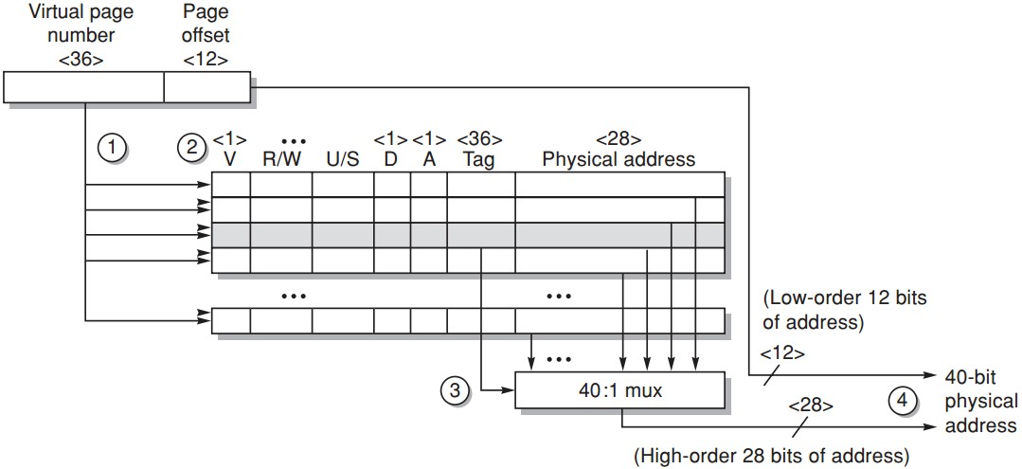
TLB Example
Opteron data TLB
Steps 1&2: send the virtual address to all tags
Step 2: check the type of mem access against protection info in TLB
https://www.youtube.com/watch?v=95QpHJX55bM
Notes:
Here’s an example of how TLB works for address translation.
First, the virtual page number is sent to compare with all tags;

Slide 129
TLB Example
Opteron data TLB
Steps 3: the matching tag sends phy addr through multiplexor
Notes:
The matching tag returns its physical page number through multiplexor;

Slide 130
TLB Example
Opteron data TLB
Steps 4: concatenate page offset to phy page frame to form final phy addr
Notes:
Then the physical page number is combined with page offset to form the physical address.

Slide 131
TLB Example
V:
R/W:
U/S:
D:
A:
valid bit
read/write permission
user/supervisor mode
dirty bit
reference bit
Opteron data TLB
Notes:
R/W: Read-only or read-write access access permission for all reachable pages.
U/S: user or supervisor (kernel) mode access permission for all reachable pages.
A: (accessed) Reference bit (set by MMU on reads and writes, cleared by software).

Slide 132
Does page size matter?
Notes:
When we studied cache, we knew that block size matters to cache performance.
Now TLB is also a cache and we use page as the basic transfer unit, does page size also affect system performance?

Slide 133
Page Size Selection
Pros of larger page size
Smaller page table, less memory (or other resources used for the memory map);
Larger cache with fast cache hit;
Transferring larger pages to or from secondary storage is more efficient than transferring smaller pages;
Map more memory, reduce the number of TLB misses;
Notes:
Let’s first see what advances can larger page size promise.
Larger cache with fast cache hit?

Slide 134
Page Size Selection
Pros of larger page size
Smaller page table, less memory (or other resources used for the memory map);
Larger cache with fast cache hit?
Transferring larger pages to or from secondary storage is more efficient than transferring smaller pages;
Map more memory, reduce the number of TLB misses;
Notes:
Let’s first see what advances can larger page size promise.
Larger cache with fast cache hit?

Slide 135
virtual address = virtual page number + page offset
physical address = tag + set index + block offset
_{size of direct-mapped cache:}
₂^{|set index|} _{x 2}^{|block offset|}
_{physically tagged}
_{virtually indexed}
Notes:
To be covered in later lectures.
One alternative to get the best of both virtual and physical caches is to use part of the page offset—the part that is identical in both virtual and physical addresses—to index the cache. At the same time as the cache is being read using that index, the virtual part of the address is translated, and the tag match uses physical addresses.
This alternative allows the cache read to begin immediately, and yet the tag comparison is still with physical addresses. The limitation of this virtually indexed, physically tagged alternative is that a direct-mapped cache can be no bigger than the page size. For example, in the data cache in Figure B.5 on page B-13, the index is 9 bits and the cache block offset is 6 bits. To use this trick, the virtual page size would have to be at least 2(9+6) bytes or 32 KB. If not, a portion of the index must be translated from virtual to physical address. Figure B.17 shows the organization of the caches, translation lookaside buffers (TLBs), and virtual memory when this technique is used.

Slide 136
virtual address = virtual page number + page offset
physical address = tag + set index + block offset
_{size of direct-mapped cache:}
₂^{|set index|} _{x 2}^{|block offset|}
If no translation for virtually indexed
page offset should cover at least both set index and block offset of direct-mapped cache address
_{➔ page size >= cache size}
_{physically tagged}
_{virtually indexed}
Notes:
To be covered in later lectures.
One alternative to get the best of both virtual and physical caches is to use part of the page offset—the part that is identical in both virtual and physical addresses—to index the cache. At the same time as the cache is being read using that index, the virtual part of the address is translated, and the tag match uses physical addresses.
This alternative allows the cache read to begin immediately, and yet the tag comparison is still with physical addresses. The limitation of this virtually indexed, physically tagged alternative is that a direct-mapped cache can be no bigger than the page size. For example, in the data cache in Figure B.5 on page B-13, the index is 9 bits and the cache block offset is 6 bits. To use this trick, the virtual page size would have to be at least 2(9+6) bytes or 32 KB. If not, a portion of the index must be translated from virtual to physical address. Figure B.17 shows the organization of the caches, translation lookaside buffers (TLBs), and virtual memory when this technique is used.

Slide 137
Page Size Selection
Pros of smaller page size
Conserve storage
When a contiguous region of virtual memory is not equal in size to a multiple of the page size,
a small page size results in less wasted storage due to internal fragmentation.
Notes:
On the other hand, smaller page size has also some advances of its own.
Main advance is conserving storage.
Reason: less internal fragmentation

Slide 138
Page Size Selection
Use both: multiple page sizes
Recent microprocessors have decided to support multiple page sizes, mainly because of larger page size reduces the # of TLB entries and thus the # of TLB misses;
for some programs, TLB misses can be as significant on CPI as the cache misses;
Notes:
For real deployment, page size is not strictly confined with a certain size.
Instead, recent microprocessors support multiple page sizes, reaping the benefits of both larger and smaller page sizes.

Slide 139
Virtual Memory =
Main Memory + Secondary Storage
Notes:
Now we discussed various key principles of virtual memory

Slide 140
Virtual Memory =
Main Memory + Secondary Storage
Notes:
But between cpu and virtual memory, there’s still cache, right?

Slide 141
Address Translation:
one more time, with cache
Notes:
So let’s review address translation once again, but with cache jumping in this time

Slide 142
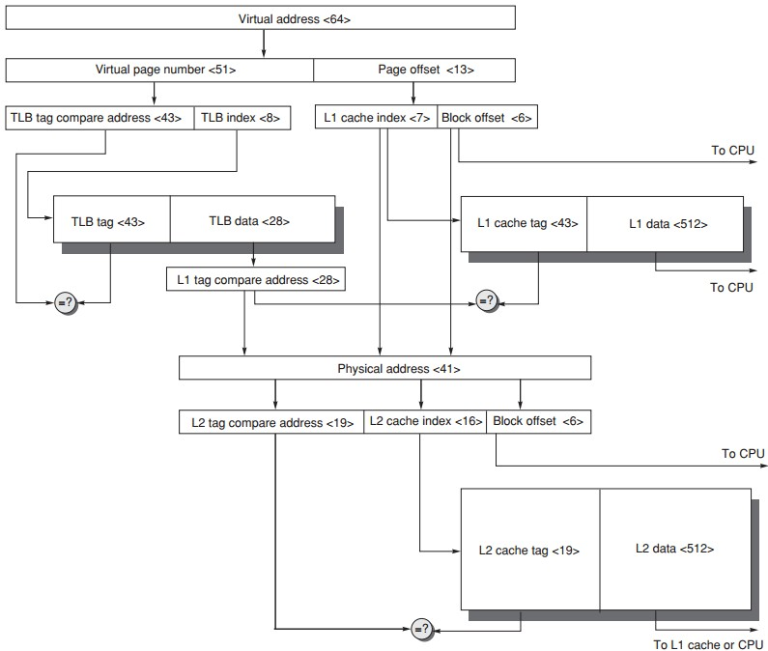
Address Translation
64-bit virtual address
41-bit physical address
page size: 8KB
two-level direct-mapped caches
64-byte blocks
L1: 8KB
L2: 4MB
TLB 256 entries
Notes:
TLB index for set?
With virtual memory, TLBs, first-level caches, and second-level caches all map- ping portions of the virtual and physical address space, it can get confusing what bits go where. Figure B.25 gives a hypothetical example going from a 64-bit vir- tual address to a 41-bit physical address with two levels of cache. This L1 cache is virtually indexed, physically tagged since both the cache size and the page size are 8 KB. The L2 cache is 4 MB. The block size for both is 64 bytes.

Slide 143
Address Translation
2¹³ = 8KB page
64-bit virtual address
41-bit physical address
page size: 8KB
two-level direct-mapped caches
64-byte blocks
L1: 8KB
L2: 4MB
TLB 256 entries

Slide 144
Address Translation
2⁸ = 256 entries
64-bit virtual address
41-bit physical address
page size: 8KB
two-level direct-mapped caches
64-byte blocks
L1: 8KB
L2: 4MB
TLB 256 entries

Slide 145
Address Translation
2⁶ = 64byte block
= 41 - 13
28
64-bit virtual address
41-bit physical address
page size: 8KB
two-level direct-mapped caches
64-byte blocks
L1: 8KB
L2: 4MB
TLB 256 entries
Notes:
41-bit physical address
13-bit offset
Tag = 41– 28 bits, which is the data field of TLB entry

Slide 146
Address Translation
2⁶ = 64byte block
2¹³ = 8KB L1 cache
2⁶ = 64byte block
2⁷ = 2¹³/2⁶
28
64-bit virtual address
41-bit physical address
page size: 8KB
two-level direct-mapped caches
64-byte blocks
L1: 8KB
L2: 4MB
TLB 256 entries

Slide 147
Address Translation
28
64-bit virtual address
41-bit physical address
page size: 8KB
two-level direct-mapped caches
64-byte blocks
L1: 8KB
L2: 4MB
TLB 256 entries
2⁶ = 64byte block
2²² = 4MB L2 cache
2⁶ = 64byte block
2¹⁶ = 2²²/2⁶

Slide 148
ready?

Slide 149
Address Translation
64-bit virtual address
41-bit physical address
page size: 8KB
two-level direct-mapped caches
64-byte blocks
L1: 8KB
L2: 4MB
TLB 256 entries

Slide 150
Address Translation
28
64-bit virtual address
41-bit physical address
page size: 8KB
two-level direct-mapped caches
64-byte blocks
L1: 8KB
L2: 4MB
TLB 256 entries
Notes:
TLB data include physical page number;
It’s compared with L1 cached tag: physically tagged;

Slide 151
Address Translation
28
64-bit virtual address
41-bit physical address
page size: 8KB
two-level direct-mapped caches
64-byte blocks
L1: 8KB
L2: 4MB
TLB 256 entries

Slide 152
ready?
one more example, 6th ed.

Slide 153
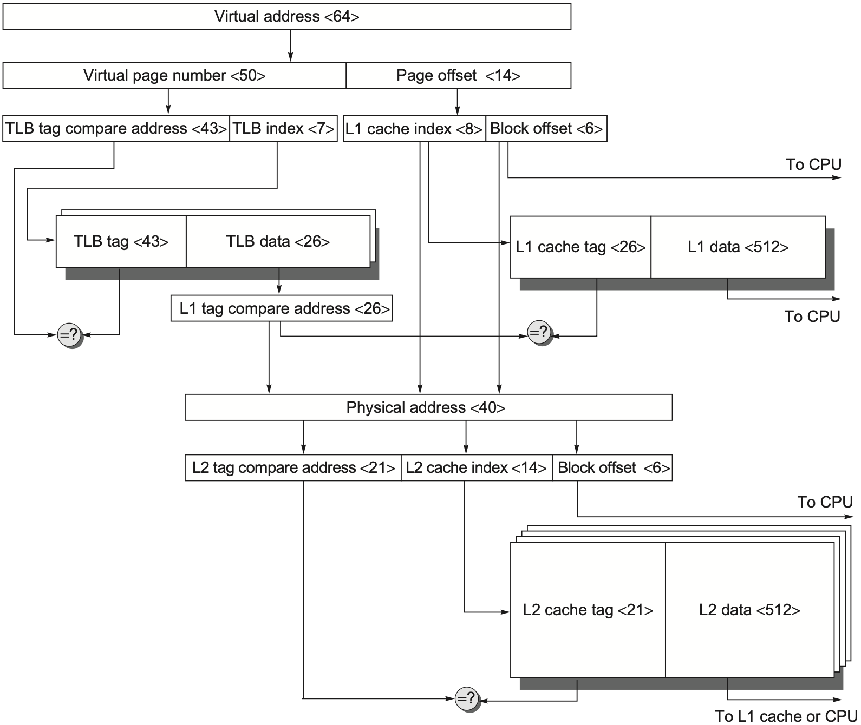
64-bit virtual address
40-bit physical address
page size: 16KB
two-level caches
64-byte blocks
L1: direct-mapped 16KB
L2: four-way set associative 4MB
TLB: two-way set associative, 256 entries
Address Translation

Slide 154
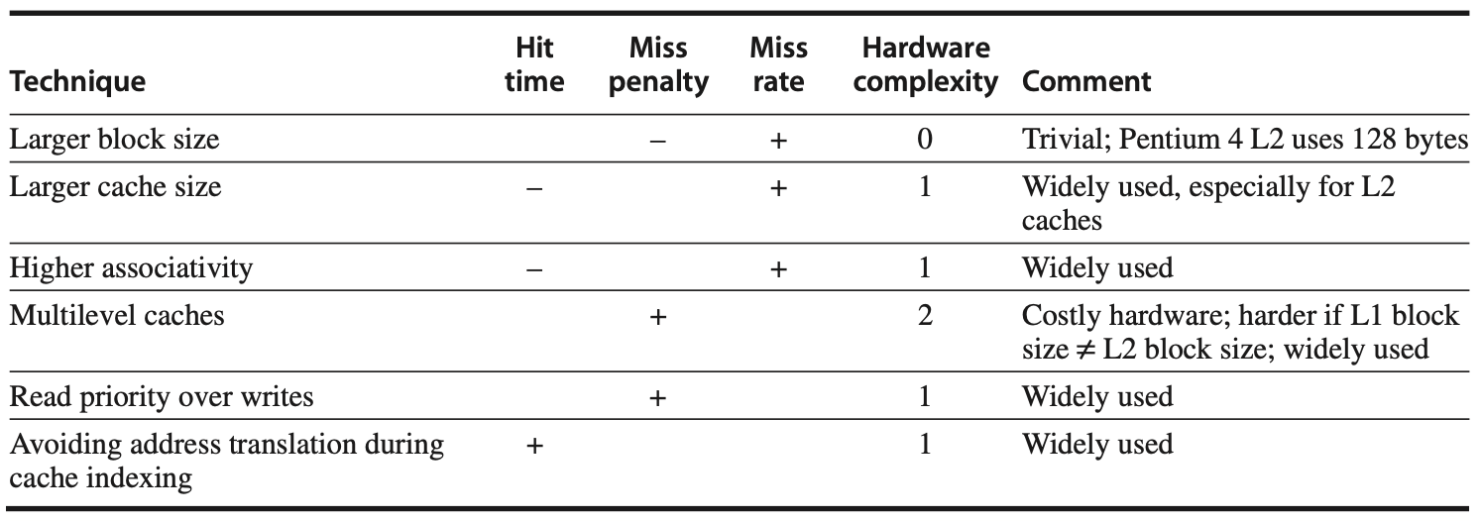
Summary of Cache Opt

Slide 155
Appendix B
Chapter 2.1-2.2
Notes:
The following content corresponds to chapter 2 (mostly 2.1 – 2.4)
atop the basic working principles of memory hierarchy we have learnt from Appendix B.

Slide 156
Readings
Memory Hierarchy - Cache Performance
Memory Hierarchy - Virtual Memory

Slide 157
?

Slide 158

Thank You
be brave

Slide 159

toast to the ones here today

Slide 160
#What’s More
Why Get a Ph.D.? by Nick Feamster
3 Qualities of Successful Ph.D. Students: Perseverance, Tenacity, and Cogency by Matt Might
So Long, and Thanks for the Ph.D.!
by Ronald Azuma
Applying to Ph.D. Programs in Computer Science
by Mor Harchol-Balter

Slide 161
#What’s More
Graduate School: Keys To Success
by Remzi Arpaci-Dusseau
What My Mentors Taught Me
by Shan Lu

